Slide 1


Final Project Python Snake Game
Course: Introduction to Computer Science
Education: ReDI School
Teachers: Michael, Laura, Konark, Felix, Ghayda, Zohra
Student: Thao NGUYEN
[Source : Website – Great Learning]

Slide 2
Content
What is my final Project about?
What is my motivation and biggest Challenge to do this project?
Python Snake Game
Snake Game Demo
Q&A
Thao Nguyen

Slide 3
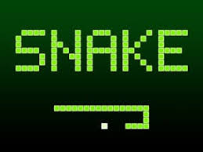
Python Snake Game [Source : Web Editor – Arduino]
What is Python Snake Game about?
Why is a game?
Why I choose Python for my project?
Learning how to program is fun and interactive way.
Python is easy-to-understand and easy-to-write code language as beginner
My future career as Data Scientist
Python Beginner and lack of structured learning approach
What is my Motivation and Challenge?
Thao Nguyen

Slide 4
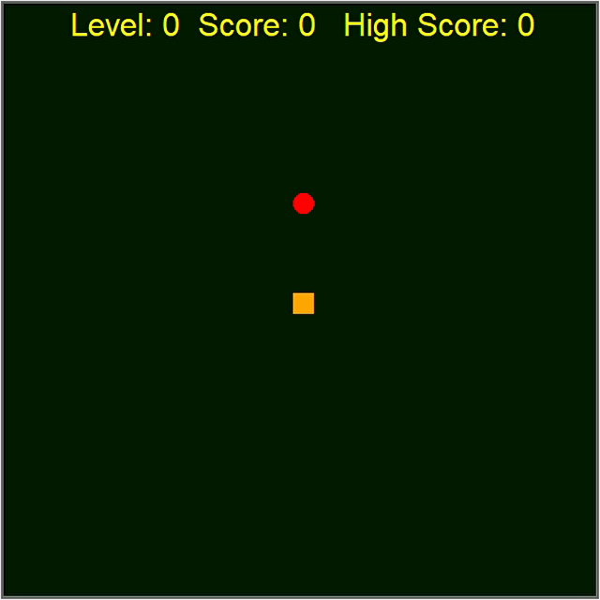
Snake Game Definition
Requirements:
Knowledges:
Data structures (Lists, Dictionaries)
Operators
I/O (print, input)
Functions
Conditional statements
Loops
Libaries:
Turtle library for drawing
Beep Sound with winsound
Random library to generate random numbers
Time library to use sleep() function
Thao Nguyen
Snake Game Definition
Snake Game Steps
Snake Game Demo
Q&A

Slide 5

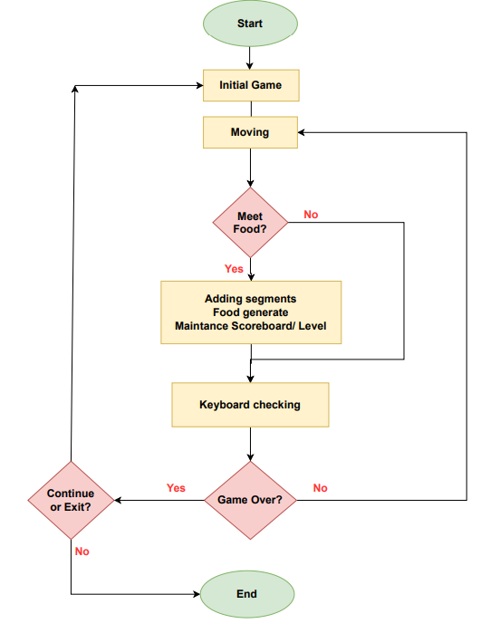
Snake Game Steps
Steps to build a Snake Game
Import module turtle, random and time
Creating a game screen
Creating a snake body
Creating a scoreboard
Creating keyboard inputting to the move the snake
Creating food for the snake
Maintaining a scoreboard with defined level
Detecting collision of the snake with food
Detecting collision of the snake with the border – Game Over
Detecting collision of the snake with its tail – Game Over
Thao Nguyen
Snake Game Steps
Snake Game Description
Snake Game Demo
Q&A

Slide 6
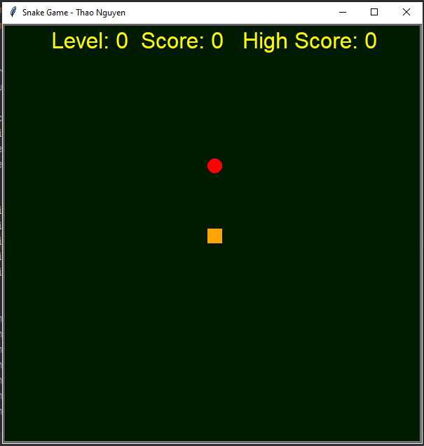
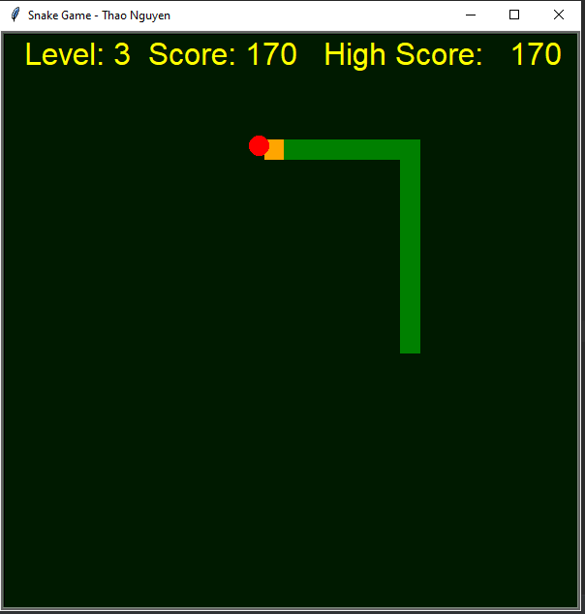
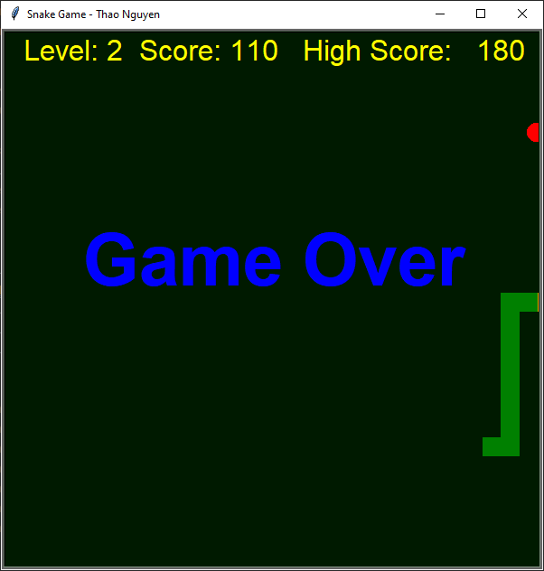
Snake Game Demo
Starting point:
Screen size 600x600 px
Level, Score and High Score is 0
Snake position at center coordinates (0,0)
Food is random position
Screen is listening keyboard‘s input
Snake is eating food:
Snake eat food and extend his body
Scoreboard updated changes with level, score and high score values
Beep sound playing when snake eat the food
Collison to border – Game Over:
Checking collision of snake movements
Game Over happens when:
Collision to border
Collision to his own body
Display Game Over in the center of screen
Thao Nguyen
Snake Game Demo
Snake Game Description
Snake Game Steps
Q&A

Slide 7


Questions and Answers
What we have learnt from this Snake Game:
[Source : Website – Real Python]
Random
Beginner:
Turtle
Sleep()
winsound
PyCharm
Operators
Functions
Loop
I/O (Keyboard Input, write)
THANK
YOU !
For Your Attention
Thao Nguyen
Q&A
Snake Game Description
Code Examples
Snake Game Demo

